Slide 1
QUANTIFYING GEOPOLITICAL
RISK IN GLOBAL OIL MARKETS:
A Data-Driven Analysis of Governance, Stability & Energy Security

Slide 2
Introduction
Objectives:
Assess geopolitical risks impacting global oil markets using a data-driven framework
Identify high-risk producers, supply vulnerabilities and market implications
Why this matters?
37.5% of global oil supply originates from high risk regions
Geopolitical instability drives price volatility and energy security concerns

Slide 3
Problem Statement
The energy industry is acutely vulnerable to geopolitical disruptions, with sudden supply shocks frequently triggering price swings exceeding 30% within weeks. Traditional risk assessments remain reactive, relying on qualitative analyst reports that fail to quantify how governance fundamentals (political stability, the rule of law and corruption control) impact production stability.

Slide 4
Research Questions
Which major oil producers have the highest geopolitical risk scores?
What percentage of global oil production emanates from high-risk (bottom quartile) countries?
How has OPEC’s geopolitical risk evolved vs. non-OPEC producers?

Slide 5
The Data
Data Sources
World Bank Governance Indicators (WGI) (World Bank)
Statistical Review of World Energy (Energy Institute)
Key variables:
Political Instability, Rule of Law & Corruption Control
Oil Production trends
Python libraries Used:
Pandas & numpy data manipulation & numerical calculations
matplotlib /seaborn- visualizations

Slide 6
Methods
Data Collection-
Data Processing: Handle missing values, normalize data, merge datasets
Composite Risk Scoring- combining governance indicators- political instability, rule of law and control of corruption.
Exploratory Data Analysis

Slide 7
Key Insights

Slide 8
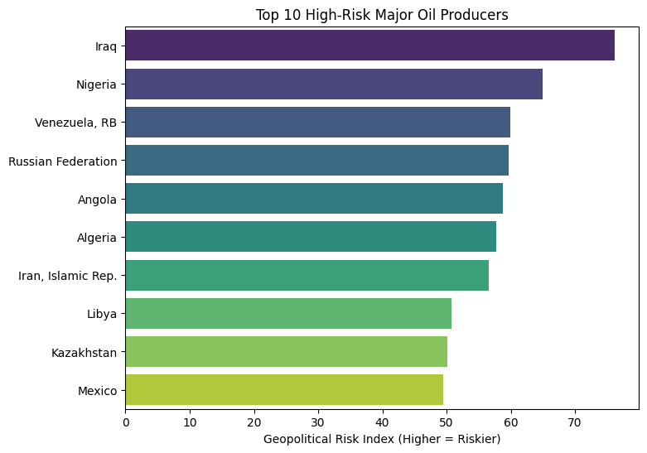

Slide 9
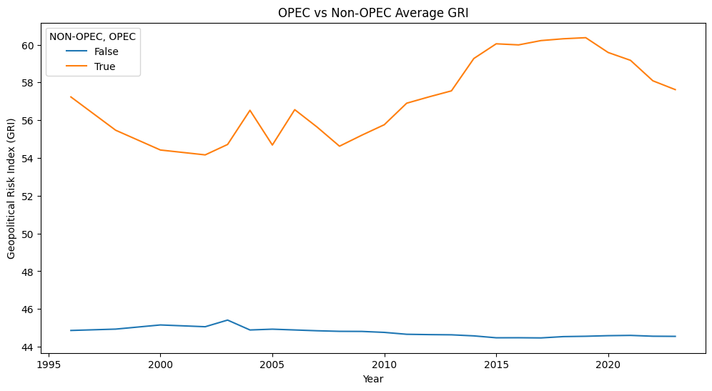

Slide 10
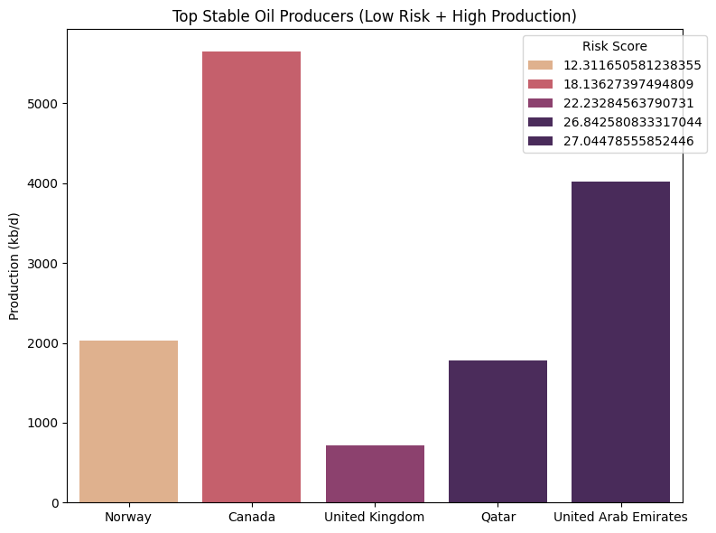

Slide 11
Recommendations
For Governments/Energy Firms:
Diversify supply chains away from high-risk producers
Invest in strategic reserves to buffer disruptions
Monitor regulatory and political shifts in real-time through AI-driven risk platforms
For Investors:
Hedge against volatility through alternative assets.
Prioritize investments in low-risk regions (e.g., U.S. shale, North Sea).

Slide 12
Future works
Sector Expansion: Natural gas and critical minerals
Policy Integration: IMF risk assessment partnerships
Real-Time Monitoring: Sanctions/conflict event alerts
Machine Learning: Disruption forecasting

Slide 13
Conclusion
Geopolitical risk is a critical but quantifiable factor in energy markets
Proactive data framework can mitigate disruptions and optimize investment strategies

Slide 14
THANK YOU

